Slide 1
MedTrack DV
HOSPITAL OPERATIONS & PATIENT ANALYTICS DASHBOARD
Infosys Springboard Virtual Internship
Presented by: [Your Name]

Slide 2
Problem Statement & Objectives
The challenge
Hospitals generate large volumes of admission, bed and staffing data, but it is scattered across reports and hard to act on. Managers need a single, interactive view of patient flow, capacity and department performance to make timely decisions.
1
Monitor Hospital KPIs
2
Analyse Patient Flow
Track admissions, occupancy, length of stay and readmission rate at a glance.
Understand admissions by month, weekday and admission type.
3
Compare Departments
4
Optimise Resources
Benchmark admissions, efficiency, stay duration and bed use.
Spot bed, staff and refusal pressure to plan capacity.

Slide 3
Solution Overview: A 4-Page Power BI Dashboard
1
Hospital Overview
2
Patient Flow
3
Department Analytics
4
Resource Utilization
Headline KPIs and admission mix by type, department and hospital.
Admissions by month and week, admission type, average stay.
Admissions, efficiency score, stay and bed use per department.
Bed and staff utilisation, beds available and patients refused.
Built in Power BI | Interactive slicers (admission date, department) | Page navigation buttons | Source files on GitHub

Slide 4
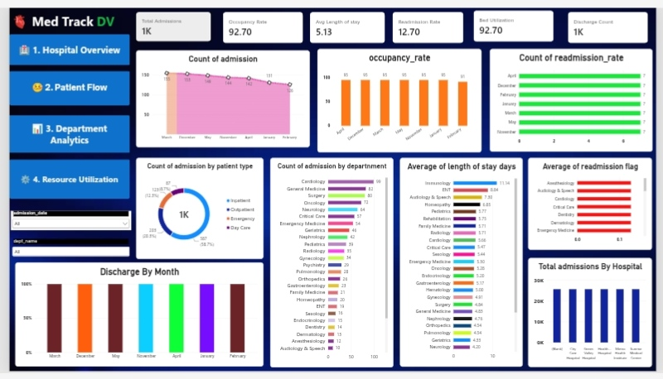
Hospital Overview
Total Admissions
Occupancy Rate
Avg Length of Stay
Readmission Rate
Bed Utilization
Discharge Count
1K
92.70
5.13
12.70
92.70
1K
Occupancy and bed utilisation both sit at 92.70, leaving very little spare capacity.
Average stay is 5.13 days; readmission rate is 12.70.
Inpatients make up the largest share of admissions.
Cardiology leads admissions by department (99), followed by General Medicine and Surgery (around 80).

Slide 5
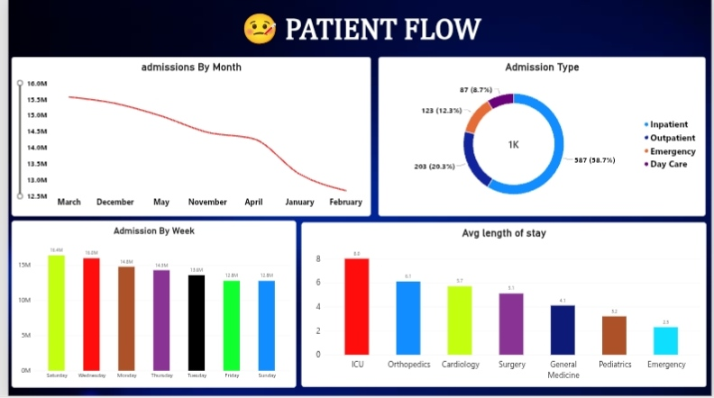
Patient Flow Analysis
Key Takeaways
Admission mix: Inpatient 587 (58.7%), Outpatient 203 (20.3%), Emergency 123 (12.3%), Day Care 87 (8.7%).
Saturday is the busiest day; Friday and Sunday are the quietest.
Monthly admissions peak in March and are lowest in February.
ICU has the longest stay (8.0 days); Emergency the shortest (2.3).
Inpatient care drives volume, and weekday load is uneven, which makes staffing rosters worth revisiting.

Slide 6
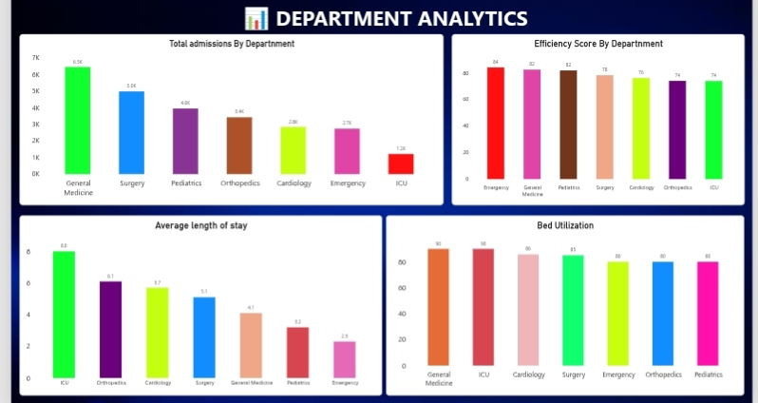
Department Analytics
Key Takeaways
General Medicine has the most admissions (6.5K), then Surgery (5.0K) and Pediatrics (4.0K).
ICU has the fewest admissions (1.2K) but the longest stay (8.0 days).
Emergency scores highest on efficiency (84); ICU and Orthopedics score lowest (74).
Bed utilisation is highest in General Medicine and ICU (90).
Efficiency does not simply follow volume: the busiest units are not always the most efficient.

Slide 7
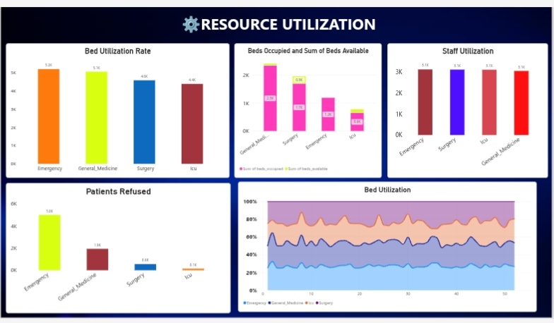
Resource Utilization
Key Takeaways
Bed utilisation rate: Emergency 5.2K, General Medicine 5.1K, Surgery 4.6K, ICU 4.4K.
Emergency has by far the most patients refused (5.0K), then General Medicine (1.9K).
Staff utilisation is similar across units (about 3.1K each).
Occupied beds far exceed free beds in every unit.
Emergency is the pressure point: highest bed demand and the most patients turned away.

Slide 8
Department Performance at a Glance
ICU and General Medicine run at 90 bed utilisation, while ICU's long stays (8.0 days) keep its beds occupied longest.

Slide 9
Key Insights & Recommendations
1
Capacity is the bottleneck
2
Reduce Emergency refusals
Occupancy of 92.70 leaves little buffer. Plan surge capacity and faster discharge workflows.
5.0K patients refused is the highest of any unit. Add triage and overflow-bed planning.
3
Balance weekly load
4
Review readmissions
Saturday peaks while Friday and Sunday are quiet. Align staff rosters to demand.
A 12.70 readmission rate suggests better discharge follow-up, especially in long-stay units.

Slide 10
Conclusion & Future Scope
What we achieved
Future scope
Built an interactive, four-page Power BI dashboard for hospital operations.
Unified KPIs, patient flow, department and resource views in one place.
Surfaced capacity pressure, Emergency refusals and uneven weekly load.
Delivered insights that support data-driven decisions.
Forecast admissions and bed demand with predictive models.
Connect live hospital data for real-time refresh.
Add cost, revenue and patient-outcome analysis.
Role-based views for administrators and department heads.

Slide 11
Thank You
MedTrack DV | Infosys Springboard Virtual Internship
GitHub: github.com/Sashank096/Infosys-Springboard-MedTrack-DV

